Slide 1
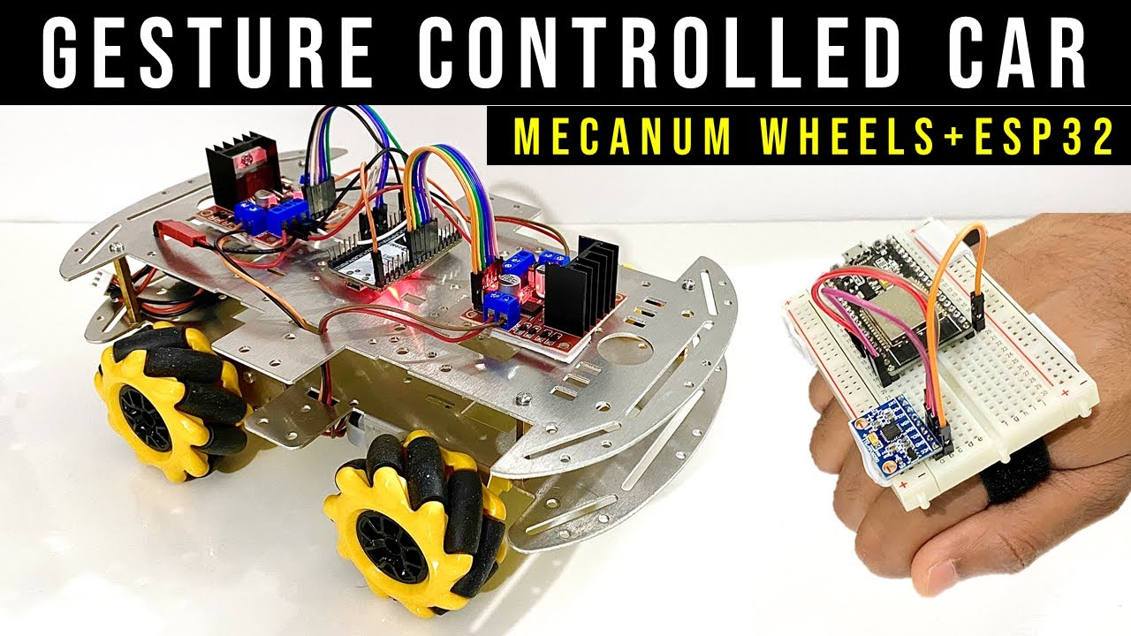
GESTURE CONTROLLED ROBOT using ESPNOW
Project By : Nagiri Sai Akshaya BTech(IoT) ACE Engineering College

Slide 2
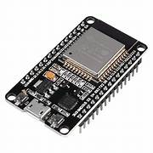
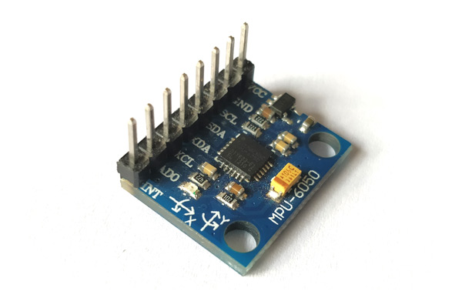
COMPONENTS USED: ESP32 MPU6050

Slide 3
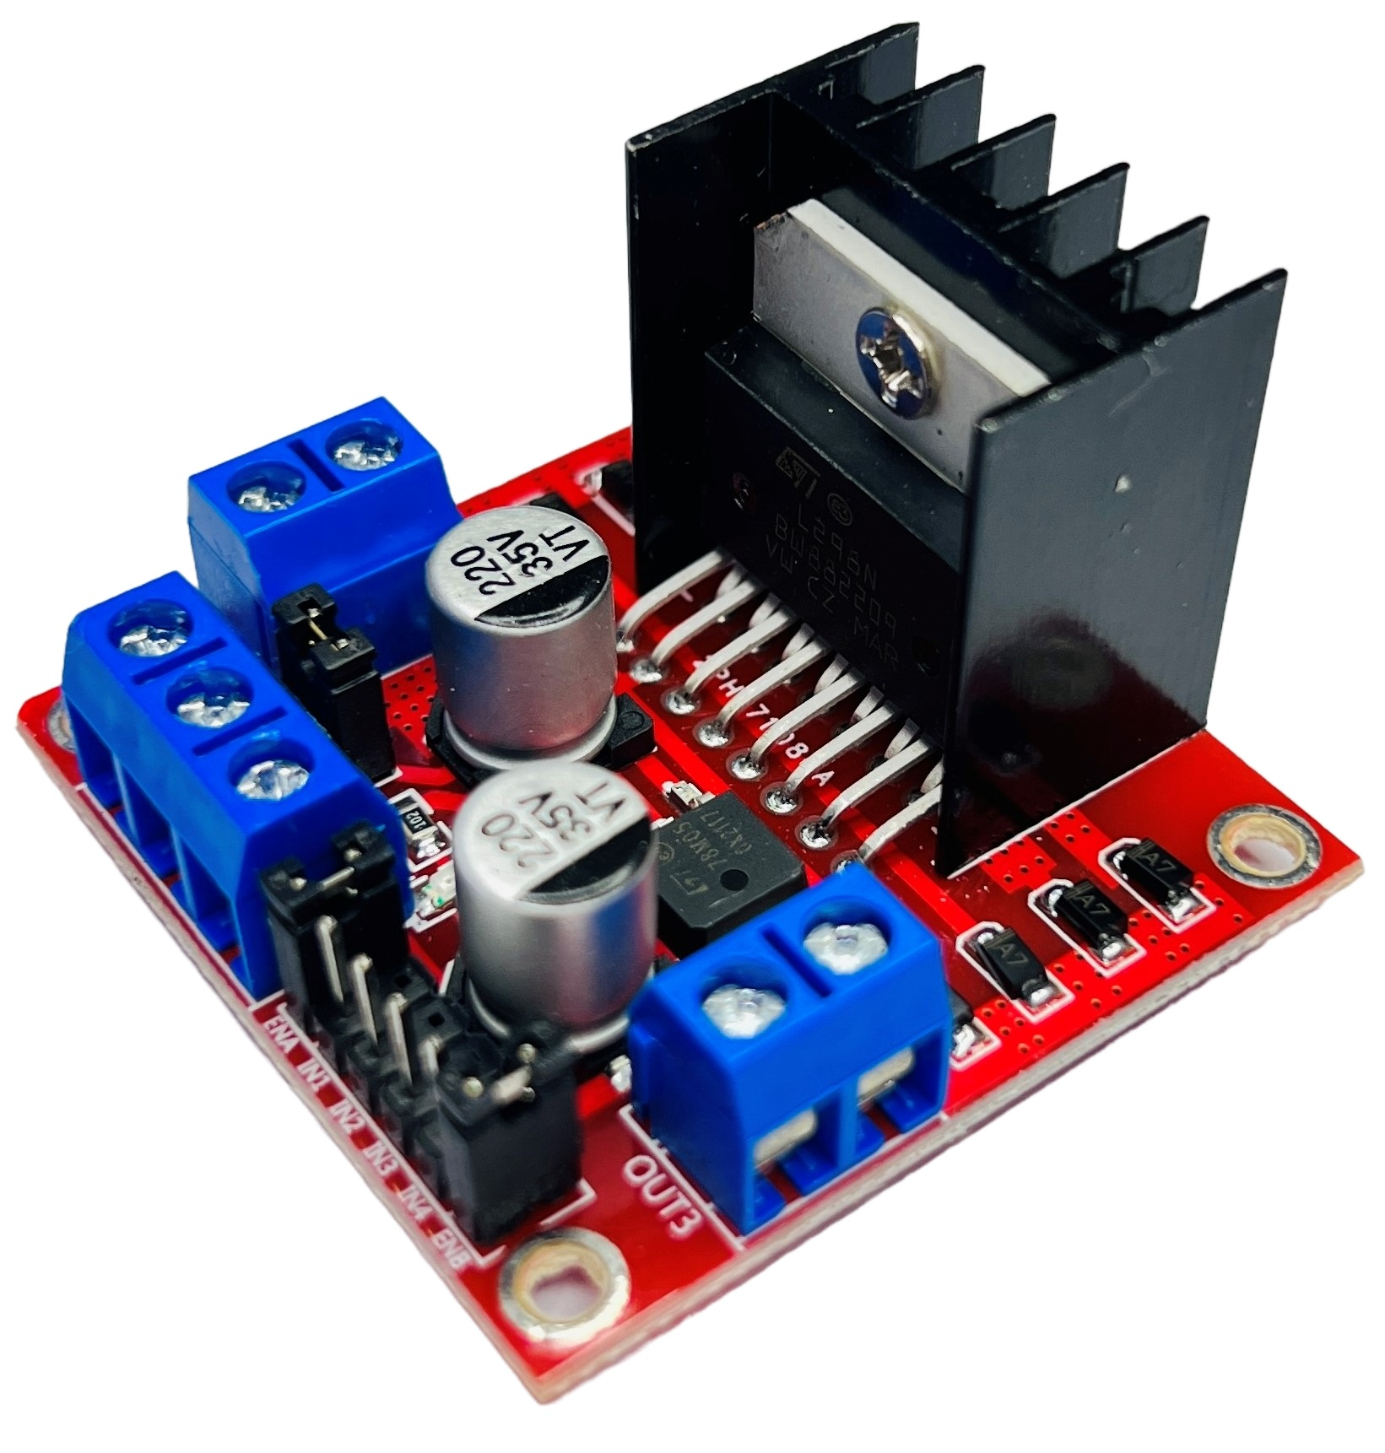
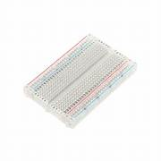
L298N Motor Driver Half Breadboard

Slide 4
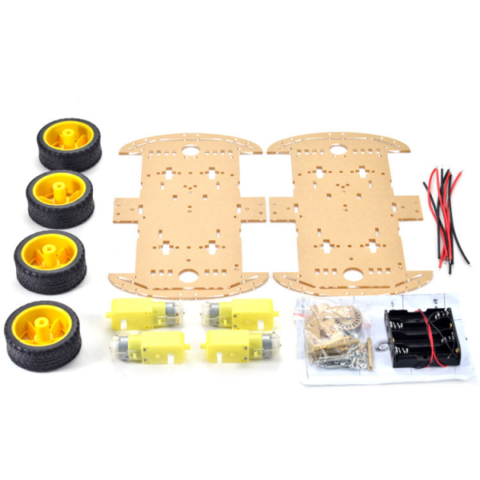
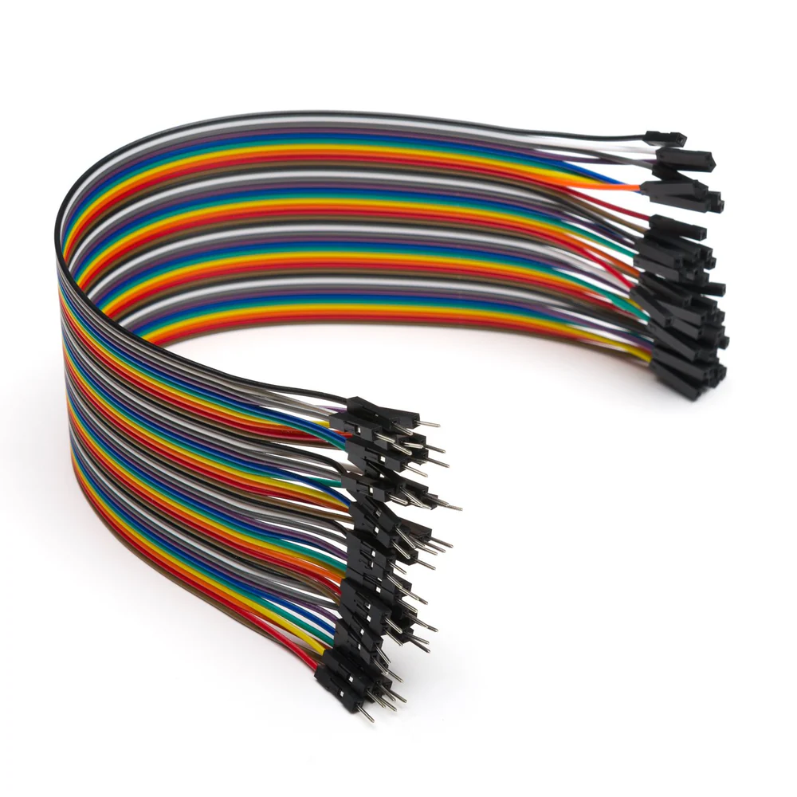
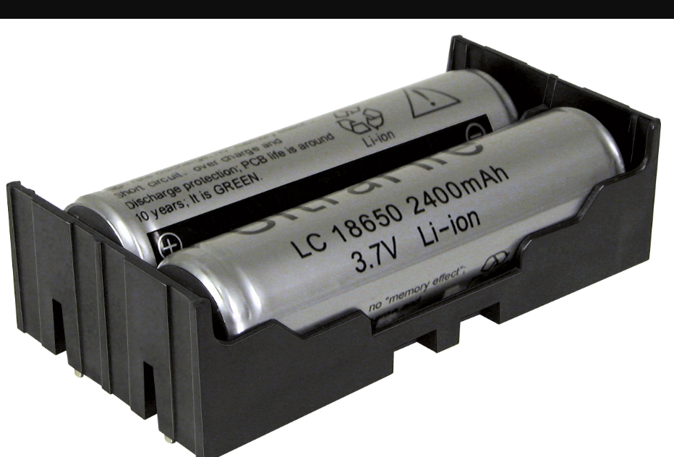
4-wheel robotic chasis Jumper wires 12v dc supply

Slide 5
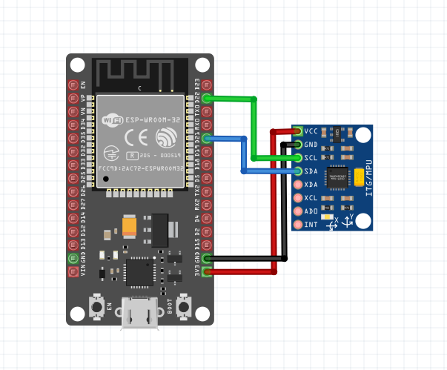
Wired Diagram: Transmitter:

Slide 6
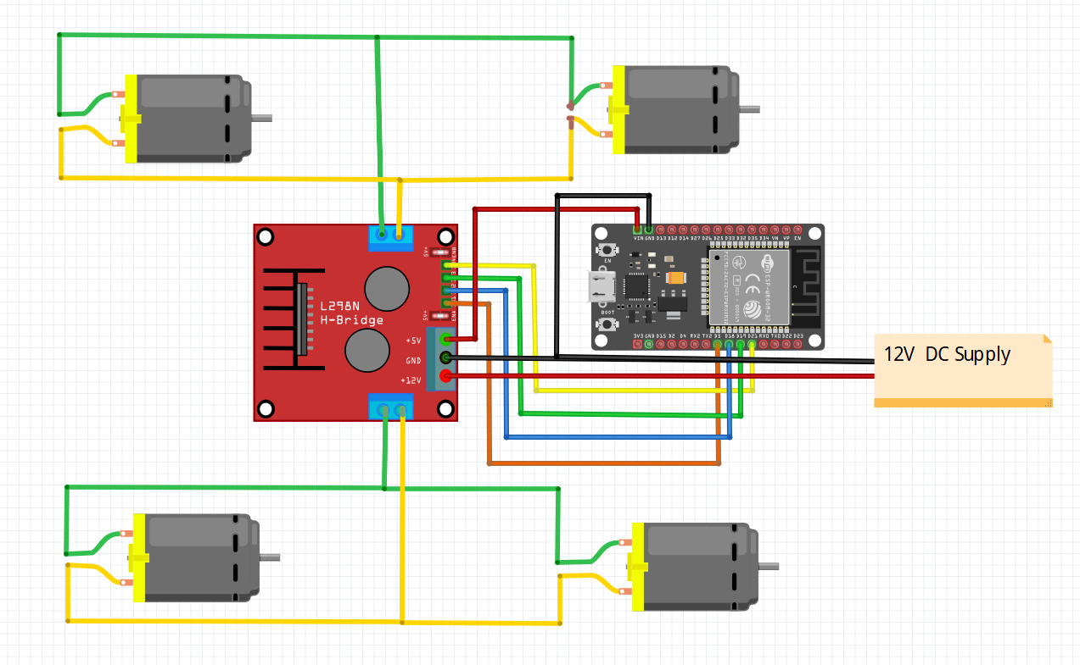
Receiver:

Slide 7
Applications:
Assistive Technology: Enable people with physical disabilities to control vehicles or devices using hand gestures.
Remote Control: Use hand gestures to wirelessly control toy cars, drones, or robots for entertainment or education.
Gaming: Create immersive driving experiences in virtual reality (VR) or simulation games using gesture inputs.
Smart Homes: Use gesture-controlled cars as part of smart home systems, where small vehicles deliver items or perform tasks within a home.

Slide 8
Challenges:
1. The communication setup between the transmitter and receiver was challenging, requiring correct initialization with their respective MAC addresses. 2. The motor control pins (IN1, IN2, and En) had to be correctly mapped to the corresponding GPIO pins on the ESP32. I faced issues when these were not properly connected, leading to motor control errors 3. Ensuring the received values (x, y, z) from the transmitter were within the expected range was another challenge. Expected day of completion: 10/11/2024

Slide 9
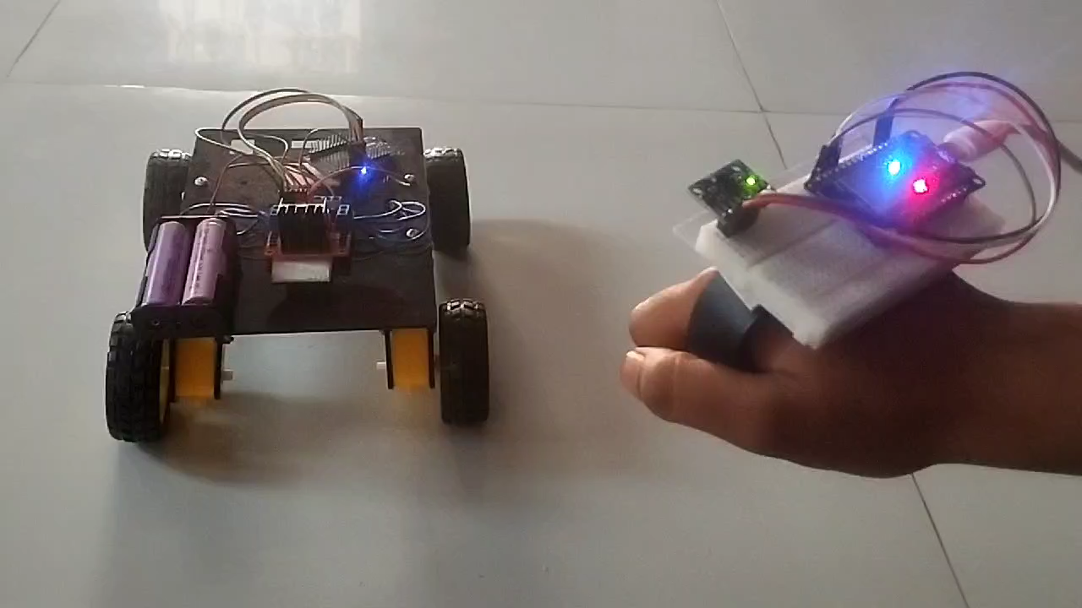
Output :

Slide 10
THANK YOU

